Slide 1
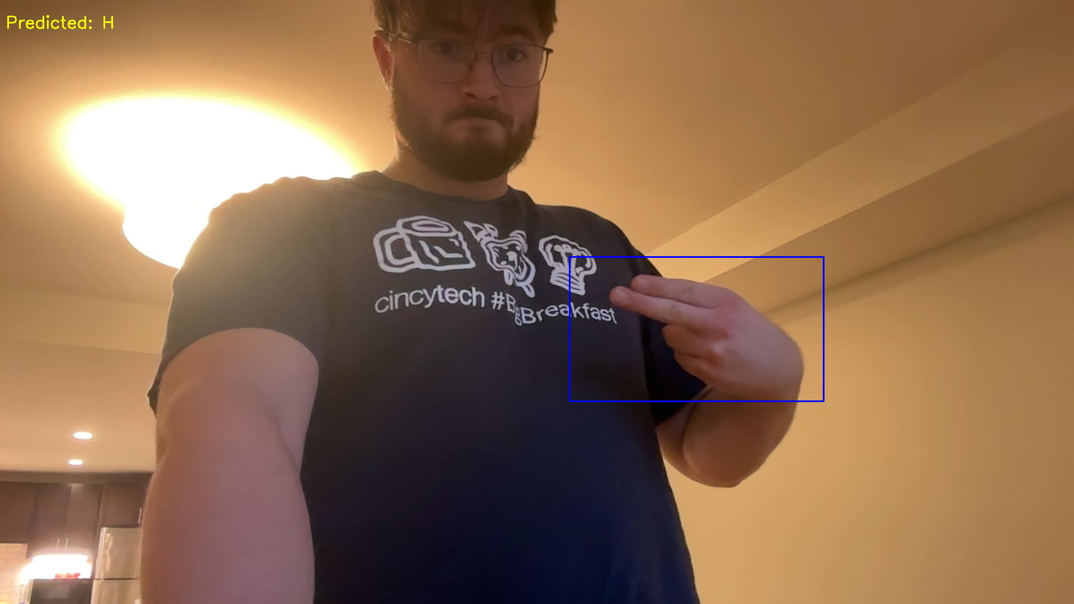
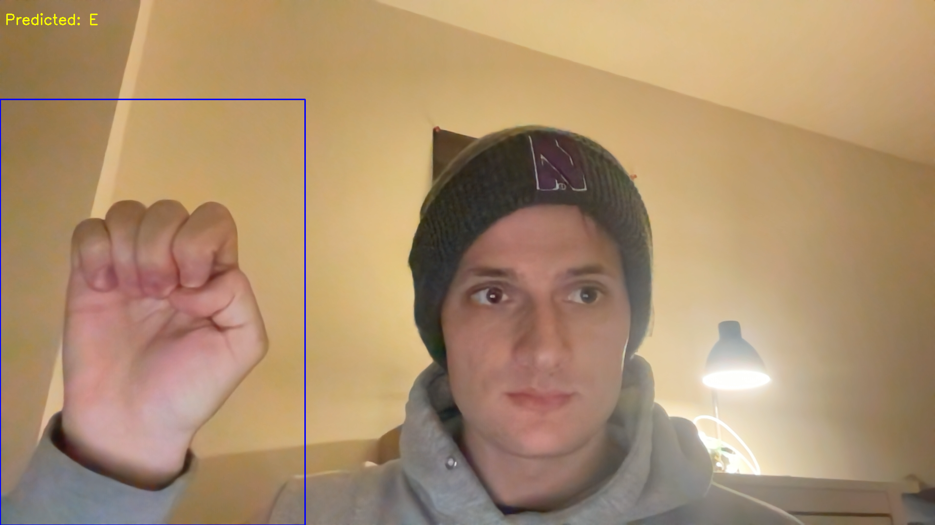
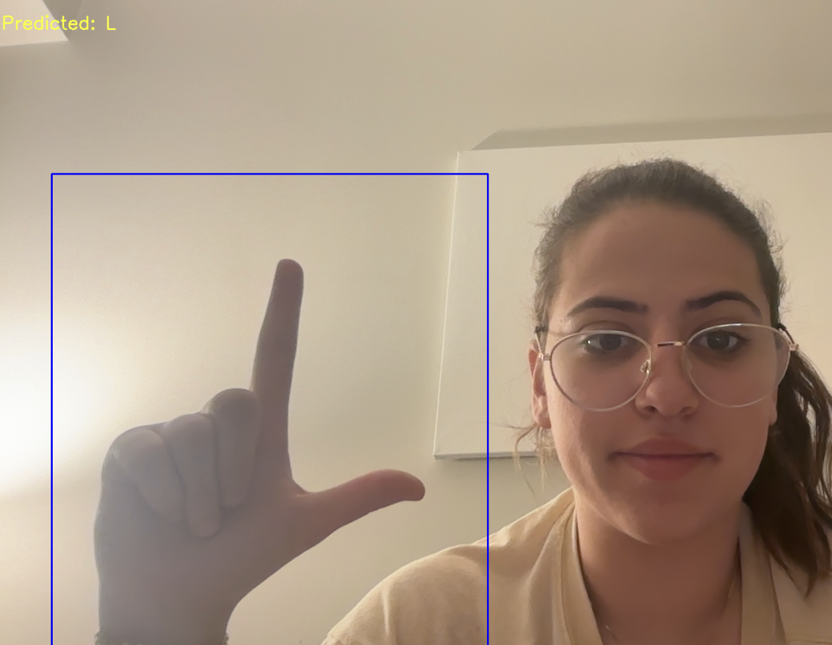
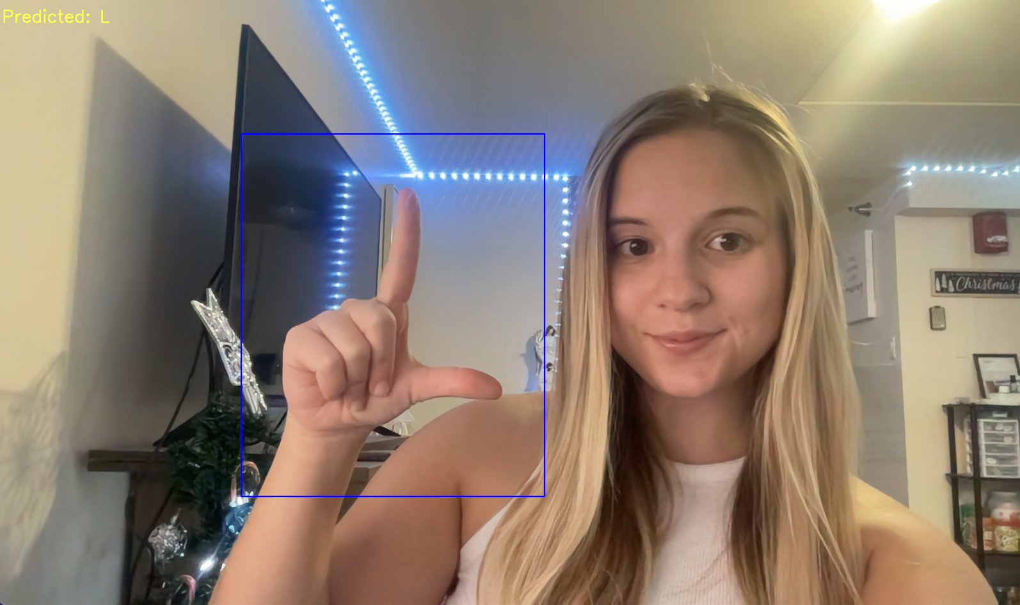
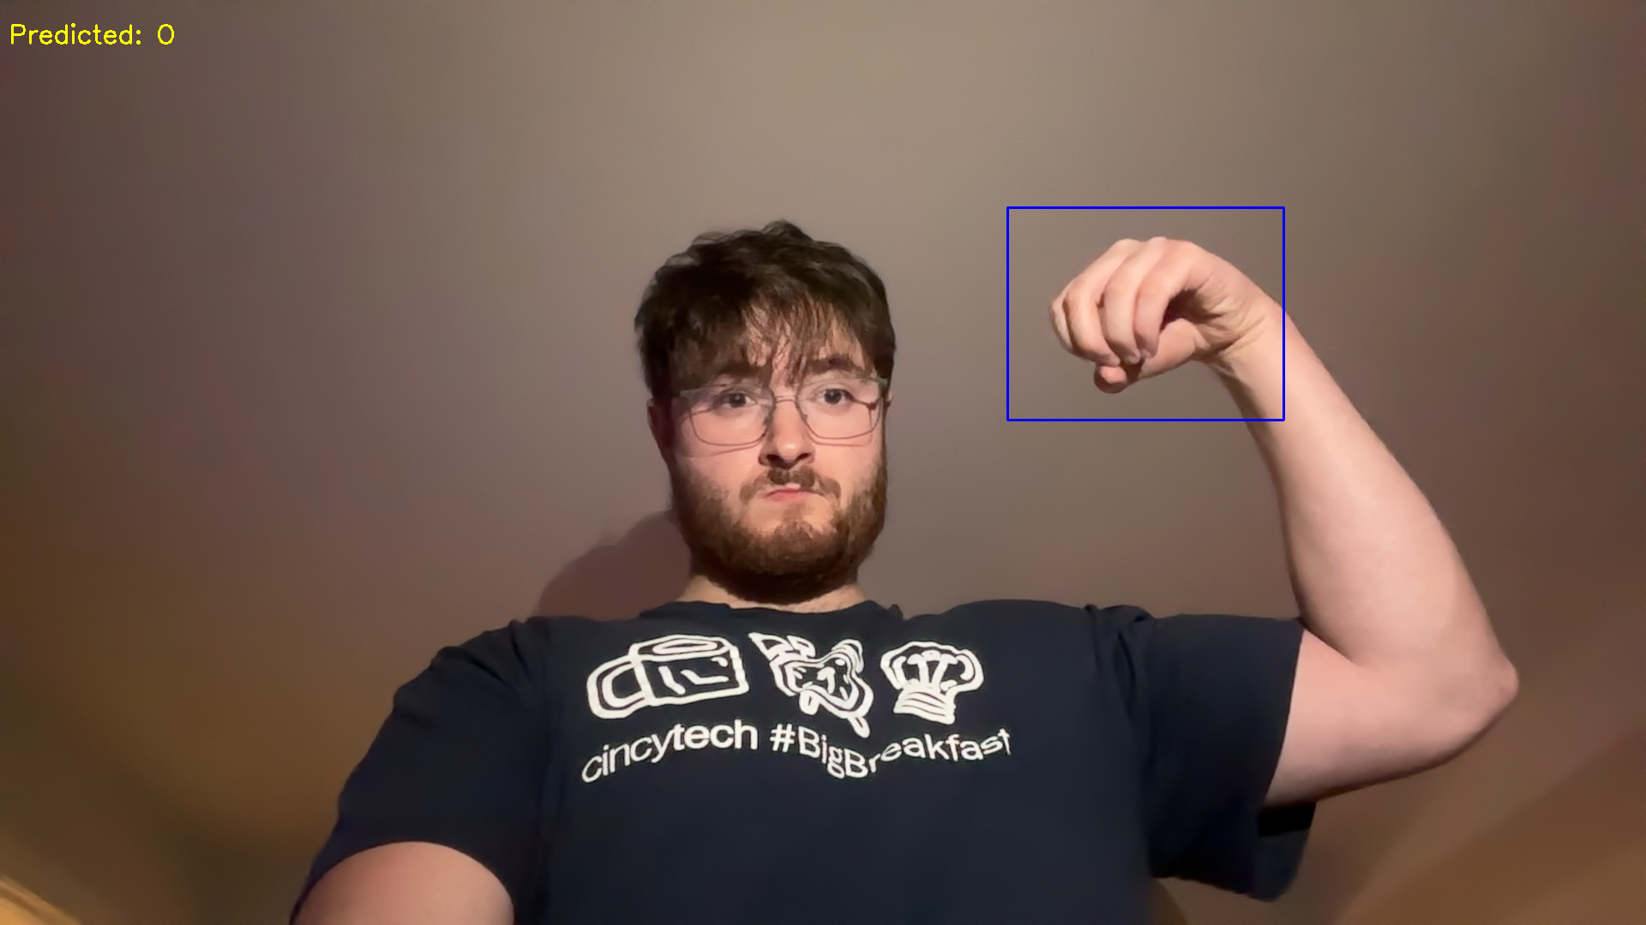
American Sign Language: Classification
Group 3: Hanna Zelis, Vrishani Shah, Dan Plotkin, Nicole Birova & Jack Hanke
Predicted: H E L L O
Notes:
Hanna

Slide 2
Introduction to the Project
This project classifies images of American Sign Language (ASL) into English letters using machine learning, significantly enhancing accessibility for individuals with hearing and speech impairments.
Accessibility: Bridges communication gaps for the hearing impaired
Technology Integration: Demonstrates the application of machine learning in real-world problems
Notes:
Hanna

Slide 3
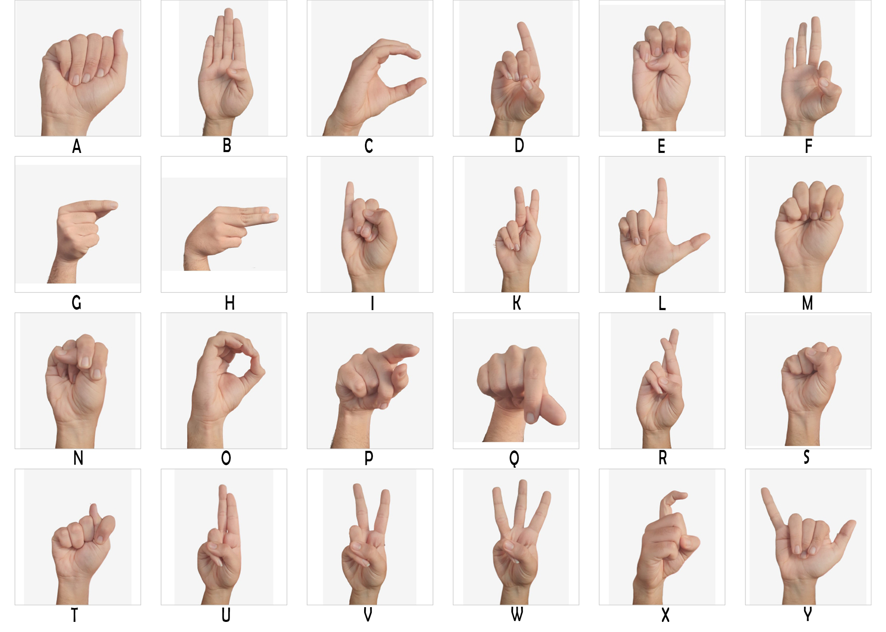
Dataset Overview
The dataset is composed of both synthetic and real ASL images, representing 29 classes.
26 English letters
3 additional gestures: space, delete, blank
Combines synthetic data with real data for diverse backgrounds and pixel values
Notes:
Hanna

Slide 4
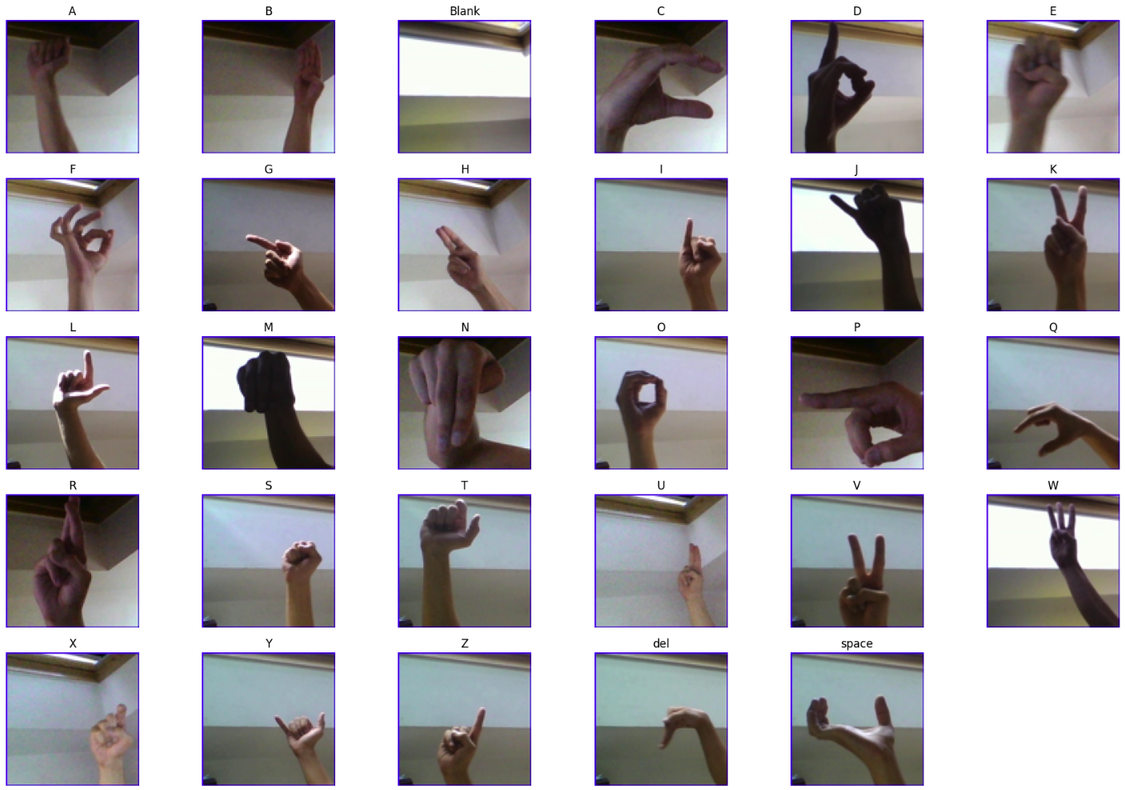
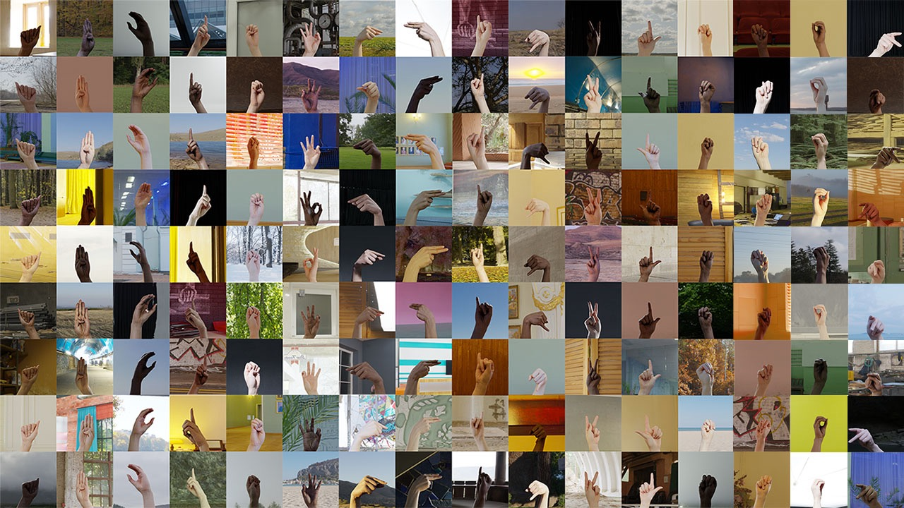
Real Data
Synthetic Data
Notes:
Hanna

Slide 5
Dataset Splitting
~80%
~10%
~10%
Training portion of the dataset - 89,040 samples.
Validation portion of the dataset - 13,560 samples
Testing portion of the dataset - 11,400 samples.
Notes:
dans_slide

Slide 6
Data Preprocessing Steps
Resizing Images
Grayscale Conversion
Image Cropping
Edge Detection / Binary Mask
Images were resized to 64x64 pixels.
Simplifies features by reducing color complexity.
Focuses on hand gestures, removing irrelevant background using MediaPipe.
Created a binary mask to specify the presence of pixels part of the hand using MediaPipe.
Notes:
dans_slide

Slide 7
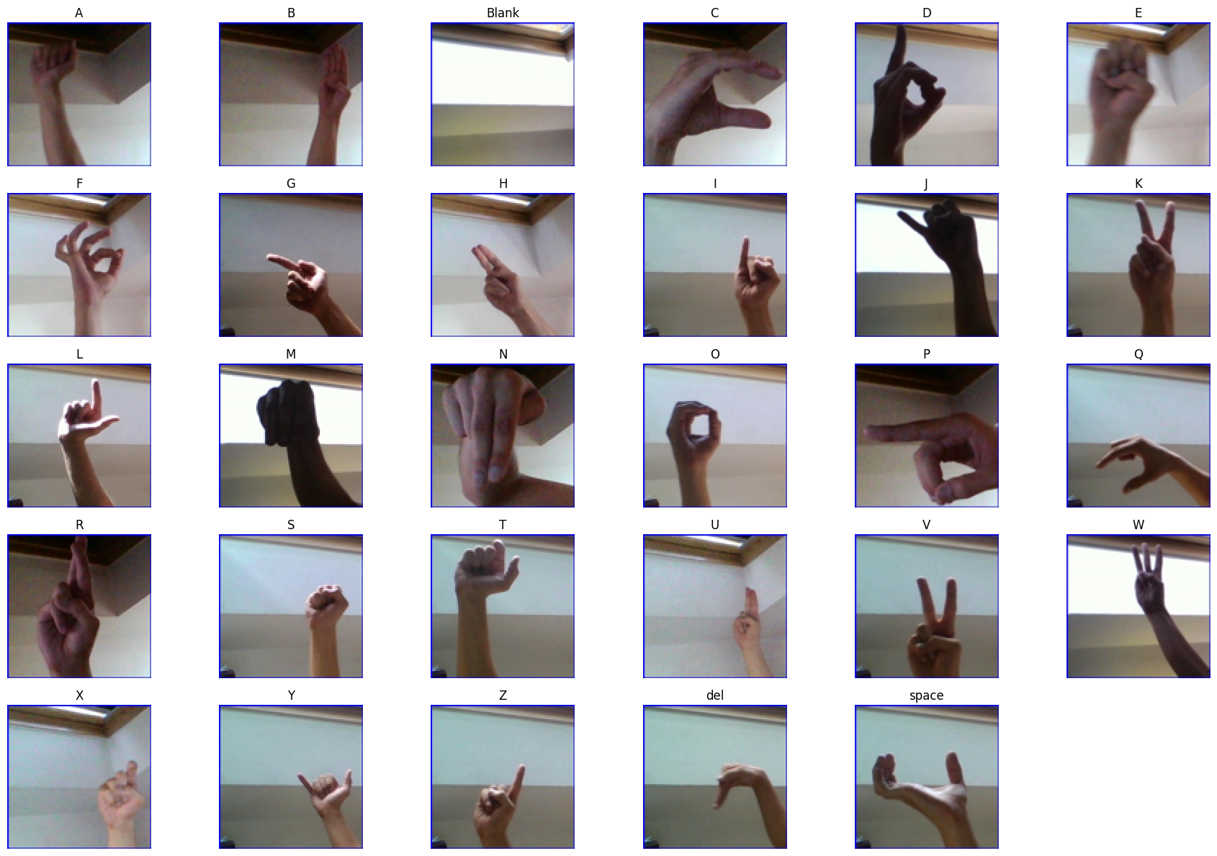
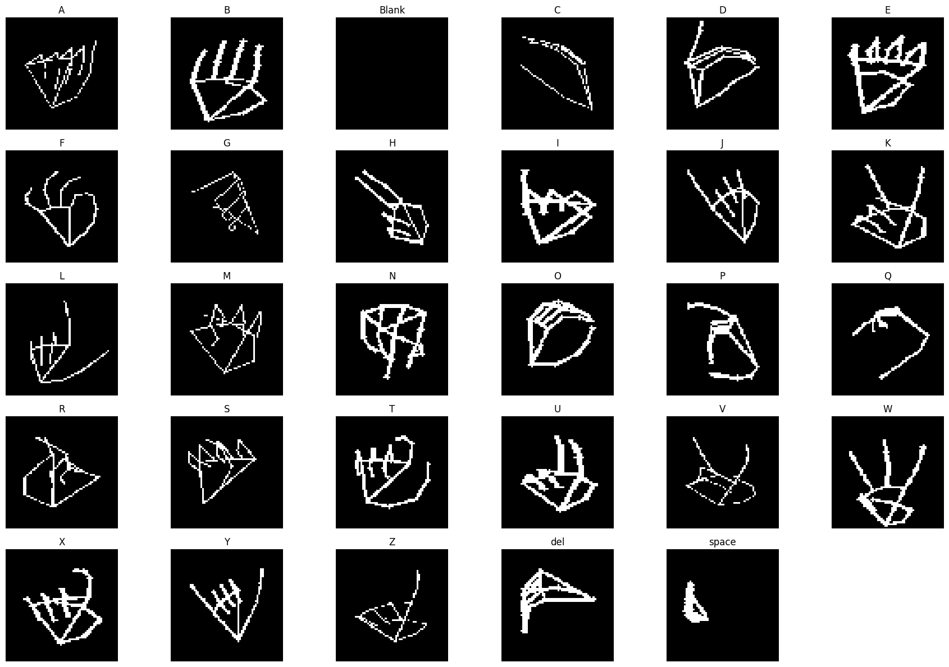
Data Preprocessing Visual
Notes:
dans_slide

Slide 8
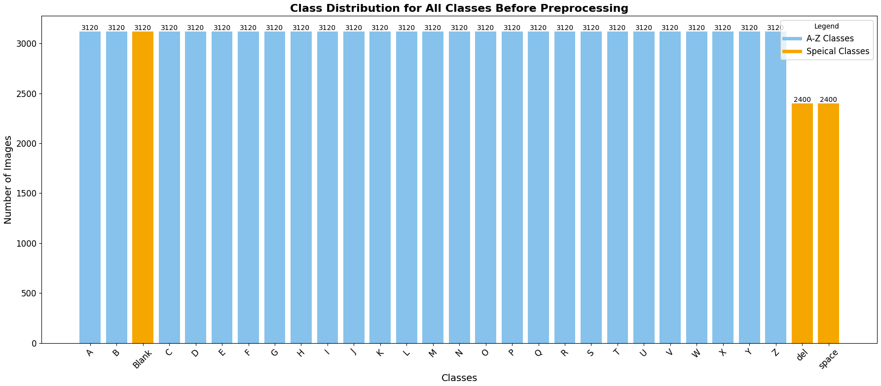
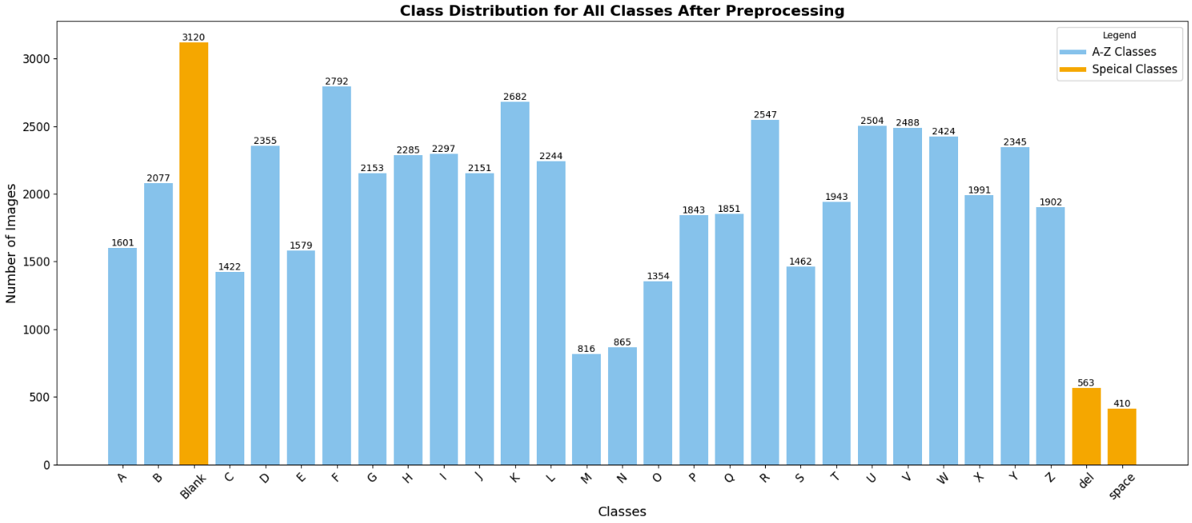
Class Distribution
Class Distribution Visualization Post Processing
Class Distribution Visualization Before Preprocessing
Notes:
Hanna

Slide 9
Feature Engineering
Flatten Pixels
Feature Scaling
Label Encoding
We flattened our (64, 64, 1) image array into a feature vector shaped (4096, ).
We used Sklearn’s MinMaxScaler to scale our pixels into a range between [0, 1].
We used Sklearn’s LabelEncoder to convert a string class labels into integers.
Notes:
dans_slide

Slide 10
Baseline Models
(KNN & RF)
We use the SciKit-Learn framework to design, train, and evaluate our baseline models: both K-Nearest Neighbors and Random Forest.
Notes:
Nicole
We used the SKLearn framework to implement both of our baseline models.

Slide 11
Performance of Baseline: K-Nearest Neighbors
Accuracy
F-1 Score
Challenges
Achieved a test accuracy of 75.72%
High performance on classes like “blank” → (Recall: 100%)
Struggles with classes like
“M” and “N” → (Recall: 38% and 46%)
Macro average F1-Score of 74%
Weighted average F1-Score of 76%
Struggles with high-dimensional, complex data
Performance diminishes with imbalanced data
Notes:
Nicole
The K-Nearest Neighbors classifier achieved a test accuracy of 75.72%, demonstrating both strengths and limitations that are characteristic of distance-based algorithms. A key strength is its ability to classify the 'Blank' class with perfect recall (100%), which underscores its efficacy in handling classes with clearly separable features.
However, its performance on more ambiguous or less frequent classes, such as 'M' (Recall: 38%) and 'N' (Recall: 46%), highlights its susceptibility to imbalanced data and overlapping feature distributions. As well as letters that look very similar in terms of hand placement and edges.
The core limitation of KNN stems from its reliance on distance metrics, which are sensitive to high-dimensional feature spaces and the choice of scaling or normalization. This sensitivity contributes to its diminished ability to generalize when decision boundaries are non-linear or when the dataset exhibits class imbalances. Additionally, the model’s equal weighting of all neighbors can result in overfitting to densely populated regions, further impairing performance on underrepresented classes.
With a macro average F1-score of 74%, KNN demonstrates modest overall effectiveness but is not well-suited for problems requiring nuanced decision boundaries or robust handling of class imbalance. Looking at the weighted average, it slightly improves to 76%, showcasing that the KNN model has a mediocre performance across classes.
While its simplicity and low computational cost at training time are appealing, these trade-offs limit its scalability for more complex classification tasks.

Slide 12
Performance of Baseline: Random Forest
Accuracy
F-1 Score
Challenges
Achieved a test accuracy of 89.52%
High performance on classes like
“H” → (Recall: 95%)
“G” → (Recall: 90%)
“I” → (Recall: 94%)
Balanced Precision, Recall, and F1-Score across all classes
Macro average F1-Score of 88%
Weighted average F1-Score of 89%
Training is more computationally expensive
Performance diminishes with highly imbalanced data
Notes:
Nicole
The Random Forest classifier achieved a remarkable test accuracy of 89.52%, significantly outperforming KNN in all key metrics.
Random Forest demonstrated exceptional recall for challenging classes, such as 'H' at 95%, 'I' at 94%, and 'G' at 90%.
This consistency across most classes underscores its ability to handle both large and small class distributions effectively.
Unlike KNN, which struggled with certain underrepresented classes, Random Forest maintained robust performance across the board.
By combining predictions from multiple decision trees, it balances bias and variance effectively, reducing the risk of overfitting while maintaining high generalization.
Furthermore, it excels at learning complex, non-linear decision boundaries, making it particularly well-suited for this dataset of handwritten letters, where patterns are intricate and diverse.

Slide 13
Baseline Model Comparison Overview
Metric | KNN | Random Forest
Test Accuracy | 75.72% | 89.52%
Validation Accuracy | 67.77% | 86.91%
Macro Average F1-Score | 74% | 88%
Weighted Average F1-Score | 76% | 89%
Class with Best Recall | Blank (100%) | Blank (100%)
Class with Worst Recall | M (38%) | M (34%)
Notes:
Nicole
Looking at our results, we can see that Random Forest performs better than KNN even at the baseline level.
Directly comparing the metrics for KNN and Random Forest, Random Forest clearly outperforms KNN across all metrics, achieving a higher test accuracy of 89.52% compared to KNN's 75.72%.
The macro and weighted average F1-scores also highlight this trend, with Random Forest scoring 88% and 89% respectively, compared to KNN's 74% and 76%. Both models achieve perfect recall on the 'Blank' class, but they struggle with the 'M' class, with KNN at 38% and Random Forest slightly lower at 34%.
Overall, these metrics emphasize Random Forest’s superior generalization capabilities.
While KNN is a straightforward and interpretable model, it struggles with imbalanced and complex datasets, making it less suitable for real-world challenges.
On the other hand, Random Forest is better equipped for large datasets, offering balanced performance across all classes. However, its decision-making process is less transparent, and it requires more computational resources.
These insights underline the strengths and weaknesses of each model, helping us choose the right tool for specific scenarios.

Slide 14
XGBoost
(Ensemble Method)
We use the XGBoost library to design, train, and evaluate an XGBoost classifier.
Notes:
Vrishani
We used the SKLearn framework to implement both of our baseline models.

Slide 15
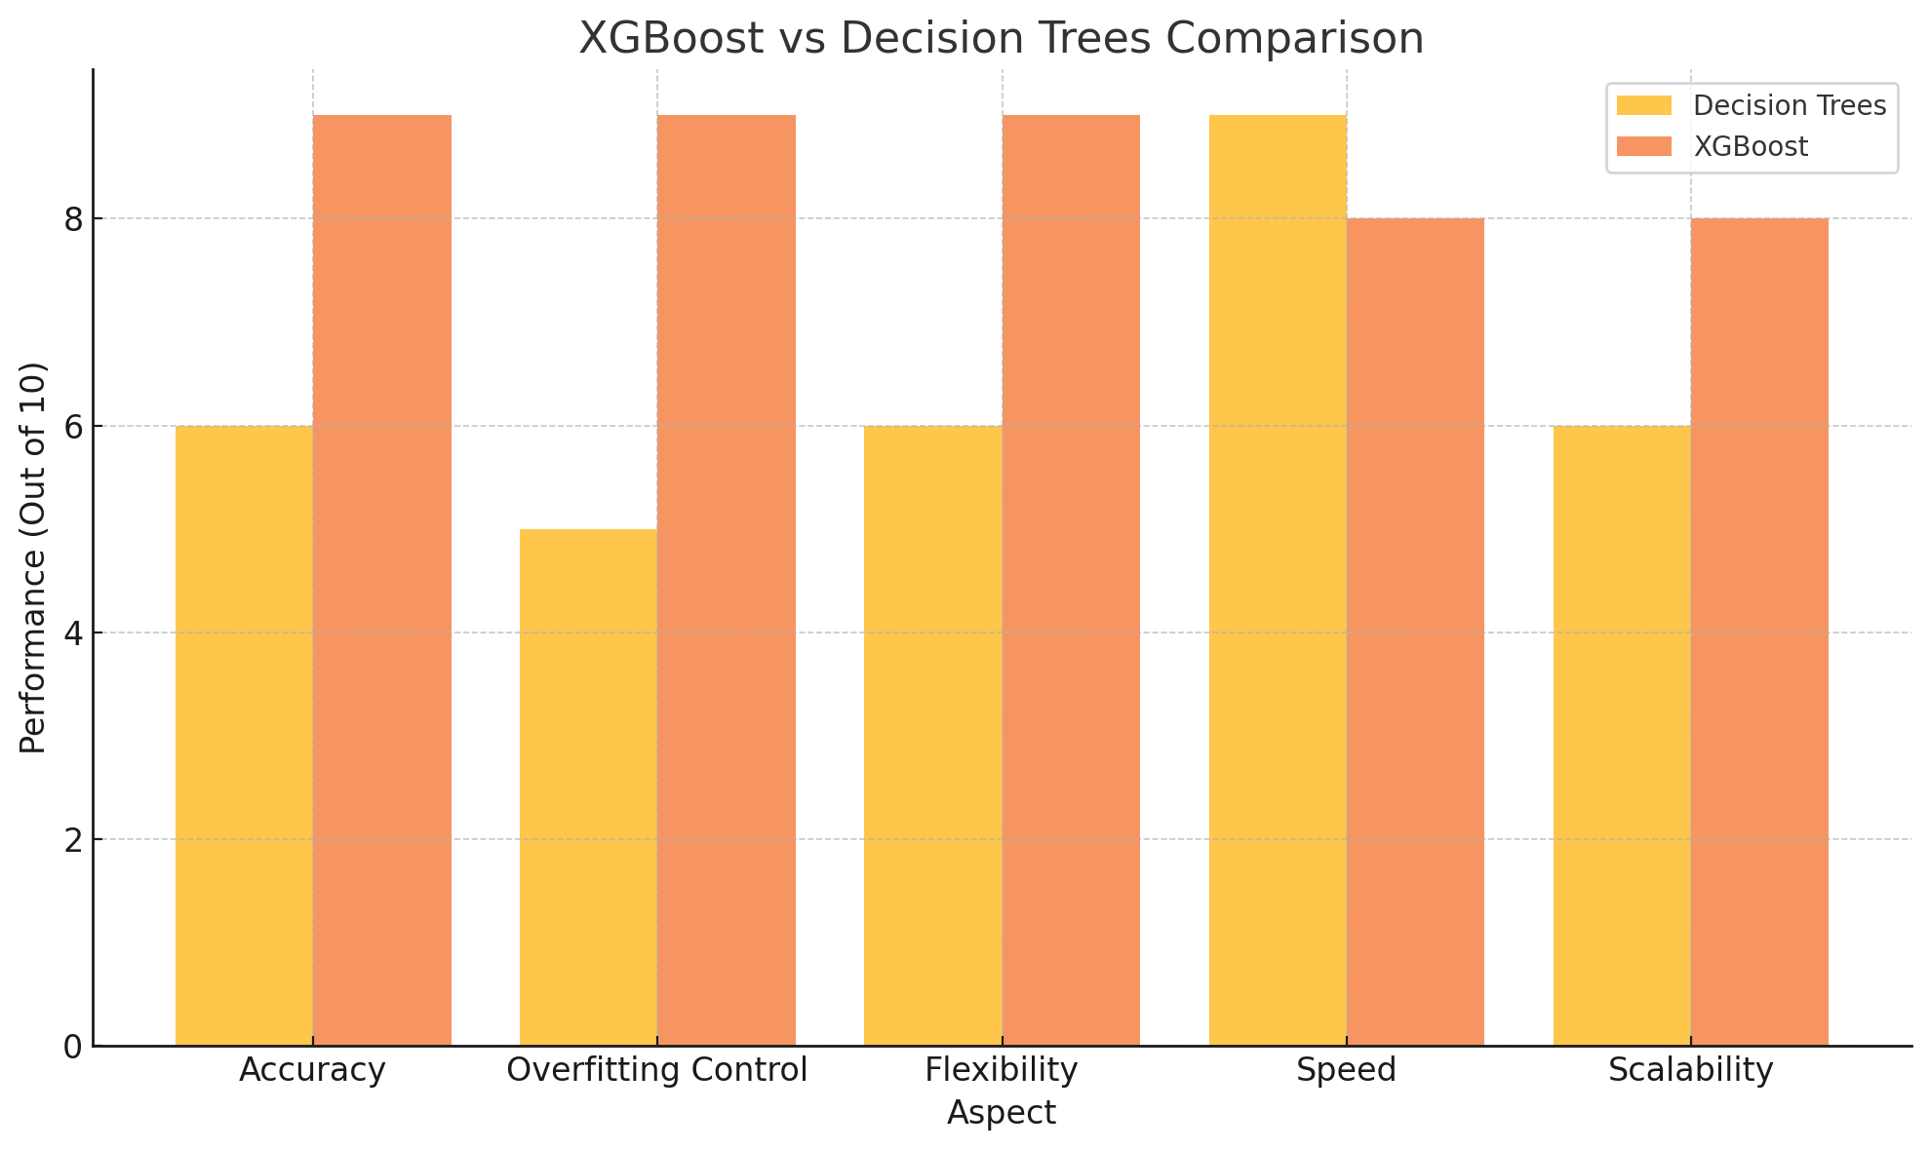
XGBoost
Why XGBoost?
Ensemble method
Gradient Boosting for residuals
Regularization
XGBoost understands the important features while training
Notes:
Vrishani

Slide 16
Performance of XGBoost
Accuracy
F-1 Score
Challenges
Achieved a test accuracy of 92.67%
High performance on classes like
“H” → (Precision: 98%, Recall: 96%)
“Blank”→(Precision: 96% , Recall: 100%)
“L” → (Precision: 94%, Recall: 97%)
Not very great with “M”, “D” and “E”
Macro average F1-Score of 91%
Weighted average F1-Score of 93%
XGBoost lacks spatial awareness and treats features (pixels) independently, making it less effective for image-based tasks where relationships between features are essential.
Notes:
Vrishani
The Random Forest classifier achieved a remarkable test accuracy of 89.52%, significantly outperforming KNN in all key metrics. Notably, its weighted average metrics—90% precision, 87% recall, and 89% F1-score—highlight its strong overall performance. These weighted averages are particularly insightful, as they account for class imbalance by giving proportional weight to each class based on its size, providing a more realistic evaluation of the model’s capabilities in a real-world setting.
Delving deeper into the results, Random Forest demonstrated exceptional recall for challenging classes, such as 'H' at 95%, 'I' at 94%, and 'G' at 90%. This consistency across most classes underscores its ability to handle both large and small class distributions effectively. Unlike KNN, which struggled with certain underrepresented classes, Random Forest maintained robust performance across the board.
The success of Random Forest lies in its ensemble-based architecture. By combining predictions from multiple decision trees, it balances bias and variance effectively, reducing the risk of overfitting while maintaining high generalization. Furthermore, it excels at learning complex, non-linear decision boundaries, making it particularly well-suited for this dataset of handwritten letters, where patterns are intricate and diverse.
In addition to its robustness against noise and class imbalance, Random Forest adapts seamlessly to diverse feature spaces and scales well with computational resources. These qualities make it not only a more accurate model but also a more reliable and practical choice for classification tasks like this one. Overall, Random Forest demonstrates why ensemble methods are often the gold standard in machine learning for complex datasets.

Slide 17
Model Comparison Overview
Metric | KNN | Random Forest | XGBoost
Test Accuracy | 75.72% | 89.52% | 92.67%
Validation Accuracy | 67.77% | 86.91% | 91.91%
Macro Average F1-Score | 74% | 88% | 91%
Weighted Average F1-Score | 76% | 89% | 93%
Class with Best Recall | Blank (100%) | Blank (100%) | Blank(100%)
Class with Worst Recall | M (38%) | M (34%) | M(58%)
Notes:
Vrishani
Looking at our results, we can see that Random Forest performs better than KNN even at the baseline level.
Directly comparing the metrics for KNN and Random Forest, Random Forest clearly outperforms KNN across all metrics, achieving a higher test accuracy of 89.52% compared to KNN's 75.72%.
The macro and weighted average F1-scores also highlight this trend, with Random Forest scoring 88% and 89% respectively, compared to KNN's 74% and 76%. Both models achieve perfect recall on the 'Blank' class, but they struggle with the 'M' class, with KNN at 38% and Random Forest slightly lower at 34%.
Overall, these metrics emphasize Random Forest’s superior generalization capabilities.
While KNN is a straightforward and interpretable model, it struggles with imbalanced and complex datasets, making it less suitable for real-world challenges.
On the other hand, Random Forest is better equipped for large datasets, offering balanced performance across all classes. However, its decision-making process is less transparent, and it requires more computational resources.
These insights underline the strengths and weaknesses of each model, helping us choose the right tool for specific scenarios.

Slide 18

Multilayer Perceptron (MLP)
We use the PyTorch framework to design, train, and evaluate our MLP.
Notes:
dans_slide

Slide 19
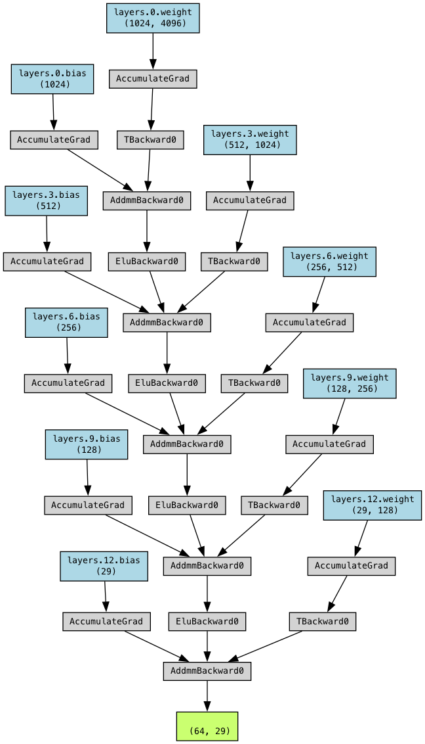
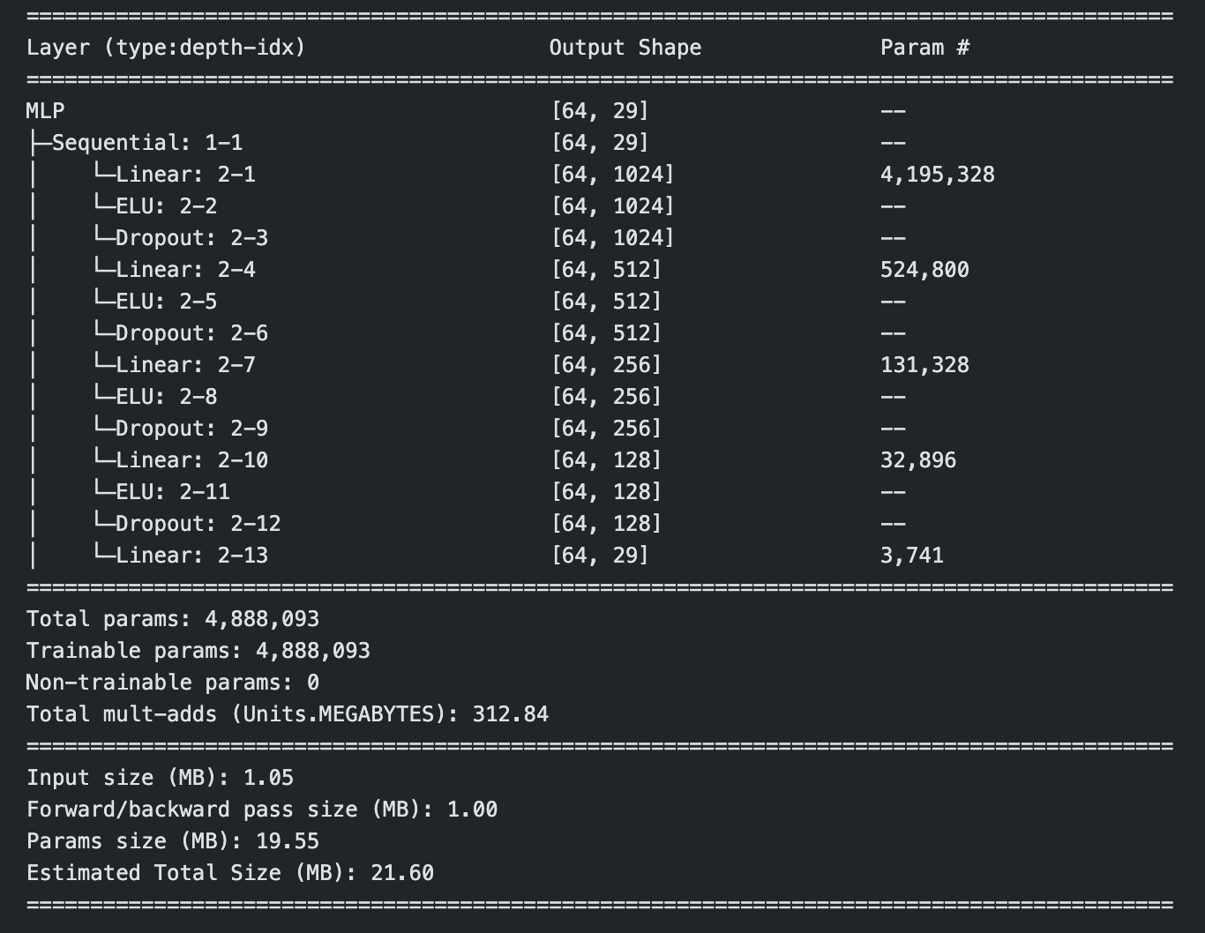
MLP - Architecture
Notes:
dans_slide

Slide 20
MLP - Regularization
Dropout
Early Stopping
L2 Regularization
We used a dropout with a probability of 0.10.
We implemented our own custom early stopping class that uses a patience of 5 increases in validation loss until the model stops training and reverts to the best weights. We give the model a maximum of 100 epochs.
We used l2 regularization, with a weight decay of 1e-4. We used PyTorch’s built in weight decay parameter within the torch.optim.Optimizer base class.
Notes:
dans_slide

Slide 21
MLP - Design Choices
Batch Size
Optimizer
Loss Function
We trained our model using mini-batch gradient descent, with a batch size of 64, using PyTorch’s DataLoader class.
We used the Adam optimizer with a learning rate of 1e-4. We used PyTorch’s torch.optim.Adam class.
We used Cross-entropy Loss for our loss function that we are minimizing. We used PyTorch’s torch.nn.CrossEntropyLoss class for our loss function.
Notes:
dans_slide

Slide 22
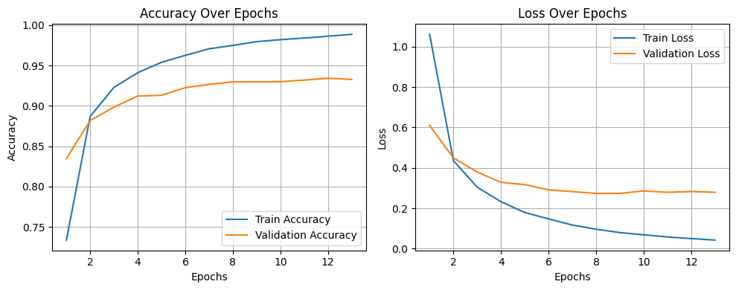
MLP - Training Curves
Notes:
dans_slide

Slide 23
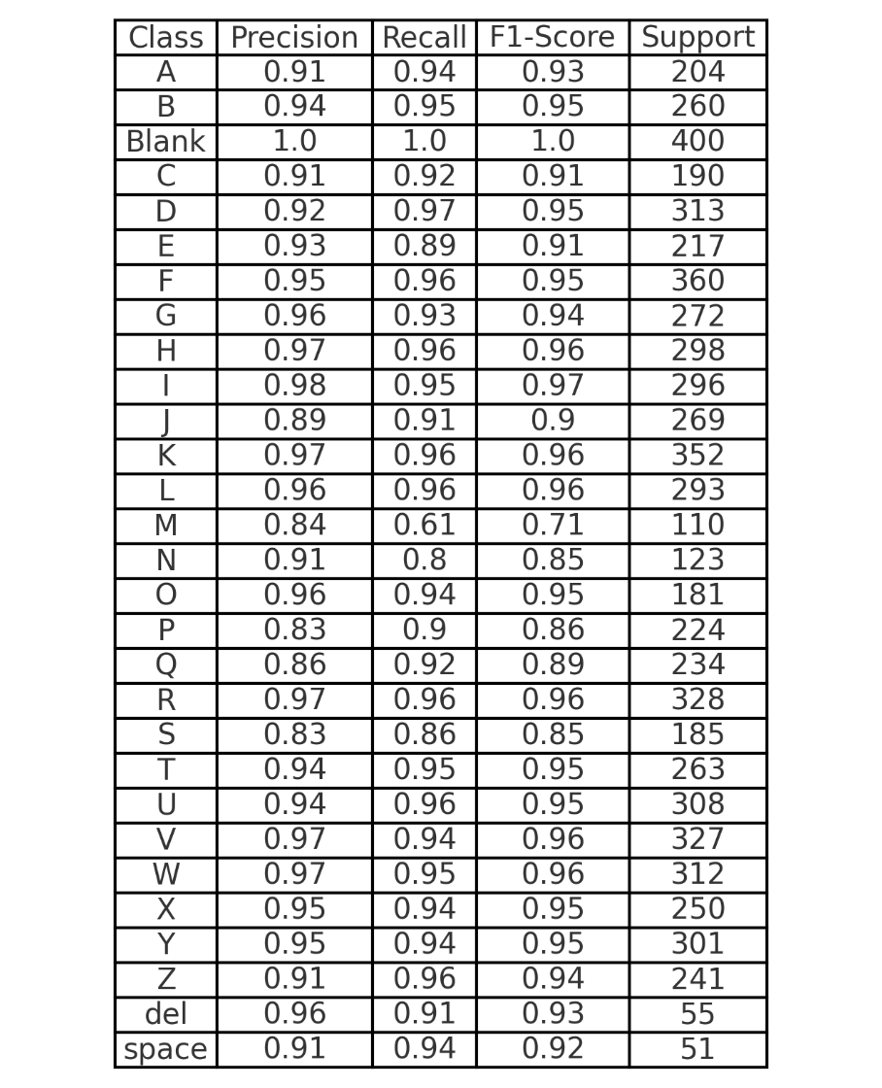
MLP - Evaluation
For our test set with 7,217 samples, we get the following metrics:
Accuracy: ~94%
Weighted Precision: ~94%
Weighted Recall: ~94%
Weighted F1-Score: ~94%
Notes:
dans_slide

Slide 24
Classification Algorithms Overview
◆ Baseline models
◆ Best model
Model | Hyperparams | Validation Accuracy | Testing Accuracy
K-Nearest Neighbors | k = 4 | 67.77% | 75.72%
Random Forest | estimators = 50 | 86.91% | 89.52%
XGboost | max_depth=6, learning_rate=0.3 | 91.91% | 92.67%
Multilayer Perceptron | [1024, 512, 256, 128]* | 93.22% | 93.74%
* See later slides

Slide 25
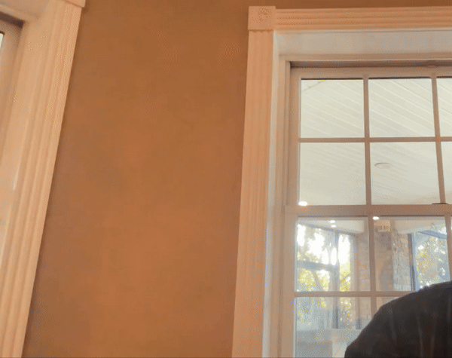
Video Demonstration 🎥
The project includes an application that conducts inference for live video. Users can sign gestures in front of a camera, and the system predicts and displays the corresponding letter.
This feature uses OpenCV and Mediapipe to
Conduct real-time inference for a trained ASL-to-letter model
Provide a user-friendly interface and control scheme to capture user signs
To the tune of Frank Sinatra
Notes:
Jack

Slide 26
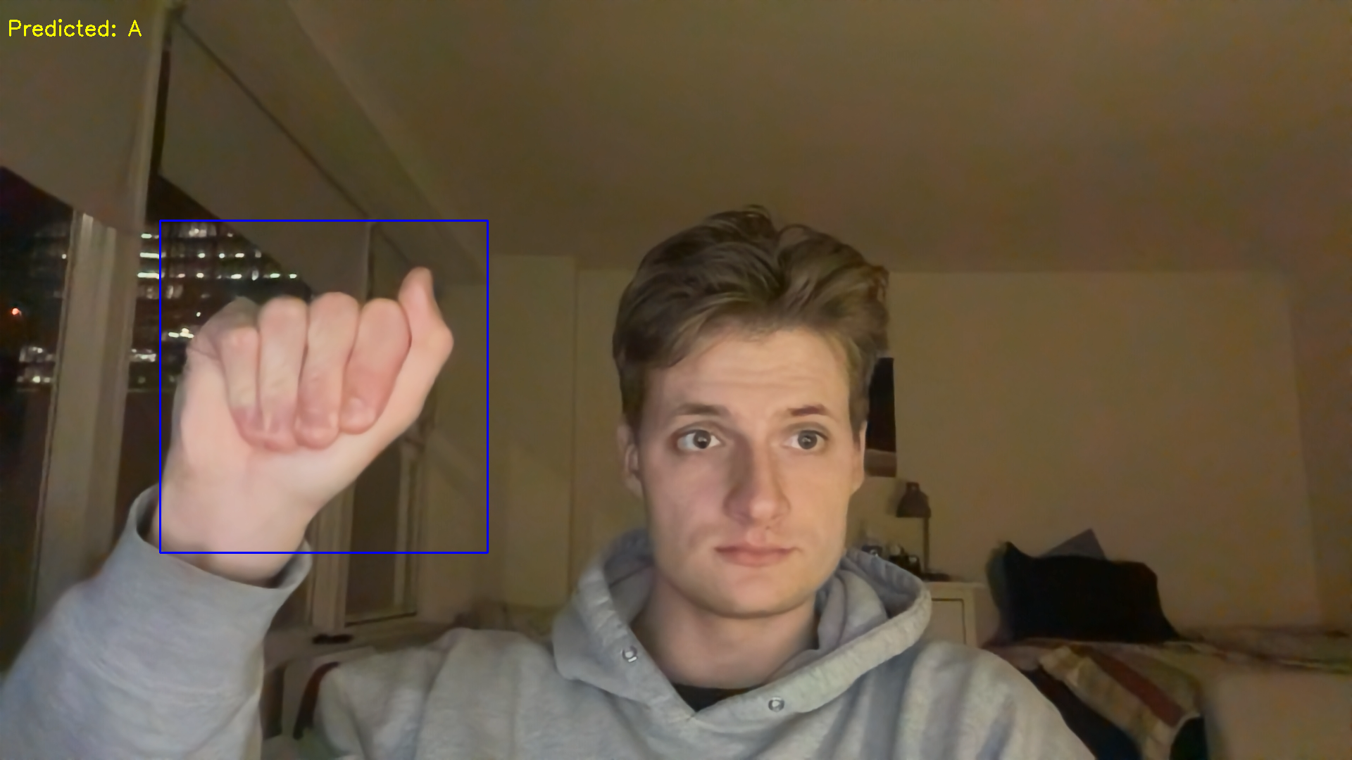
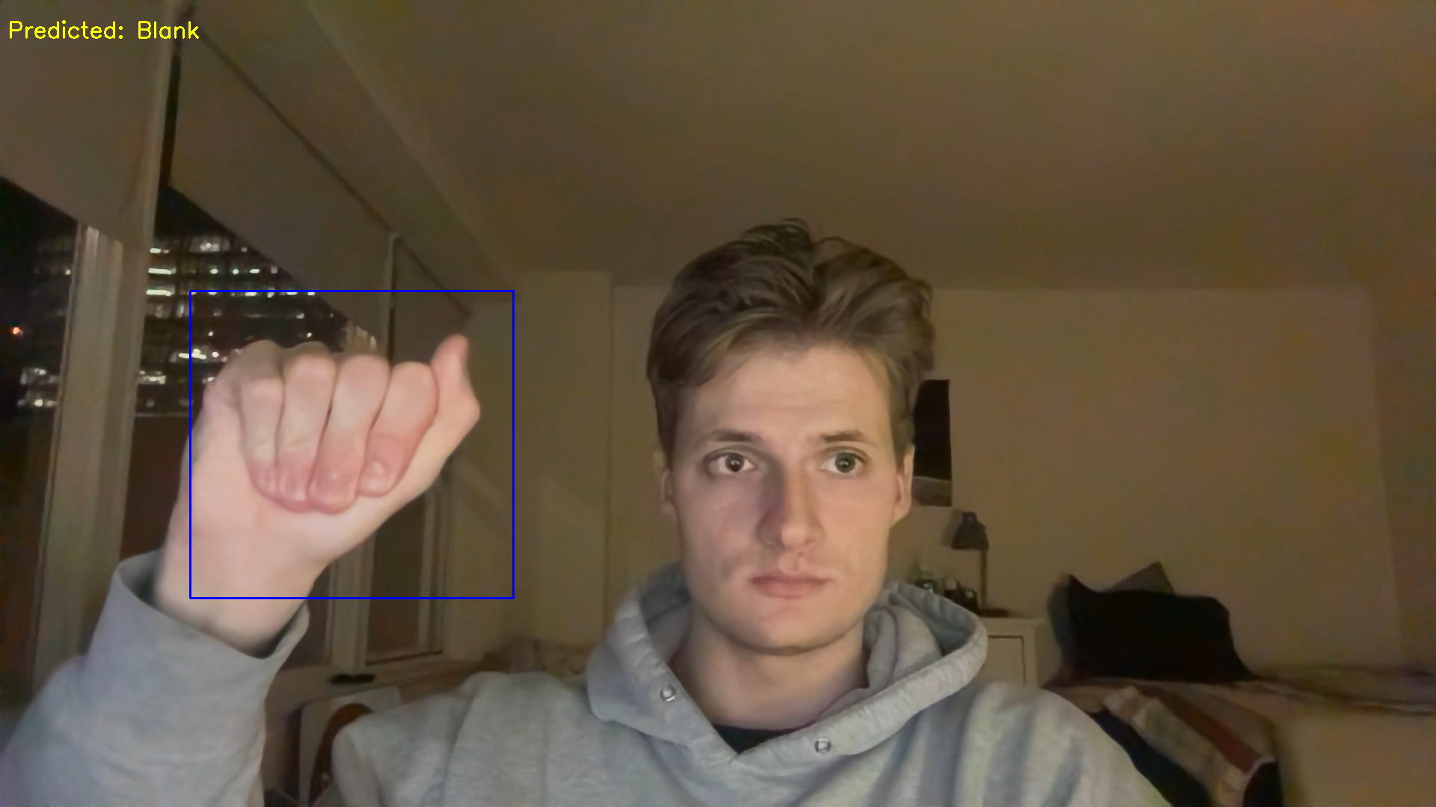
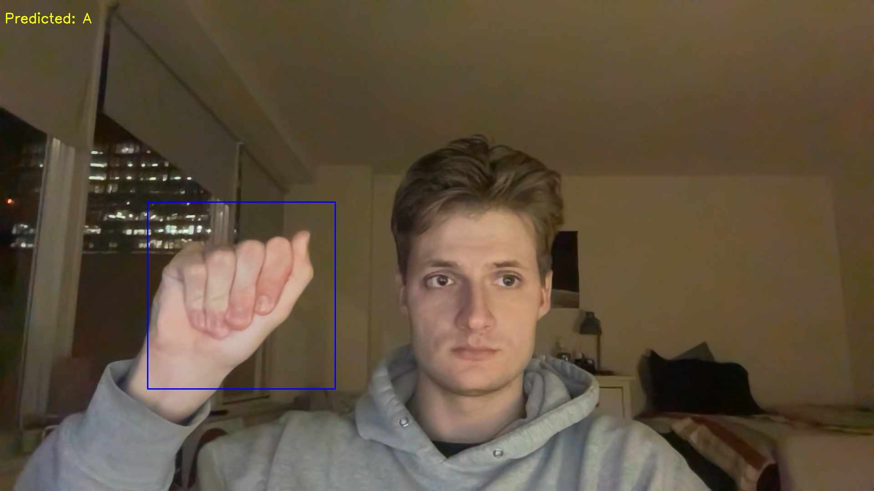
k-frame Ensemble Window
Utilizing single frame vision techniques can lead to poor perceived performance for live video. This is can be greatly improved by ensembling inferences over the last k frames
Majority vote reduces “jitteriness” of inference per frame
A con is that when a change in sign does occur, it takes longer for the prediction to change
We found a k=15 frame window served a good balance between confidence and responsiveness
Example of “jitteriness”
Notes:
Jack

Slide 27
Insights and Challenges
Key Insights
Challenges
Robust preprocessing enhances model performance.
MLP significantly outperformed the baseline model.
Proper hyperparameter tuning is essential for optimal results.
Regularization is key for preventing overfitting.
Ensembling over frames adds stability.
Handling class imbalances in the dataset.
Balancing computational costs for the MLP.
Notes:
Jack

Slide 28

Conclusions and Future Work
Future work could include…
Further refinement of preprocessing techniques
Expansion of gesture classification to include dynamic gestures
Exploration of additional machine learning models for even greater accuracy (CNNs for example)
Notes:
Jack

Slide 29


